Slide 1
Models for Setting up Circulation Desks
Yoel Kortick
Senior Librarian

Slide 2

Agenda
Introduction
Accessing the Circulation Desk Configurations
A "Circulation Only" Circulation Desk
A "Circulation and Acquisitions" Circulation Desk
A "Circulation and Digitization" Circulation Desk
A circulation desk which can register new users
A circulation desk which can accept payments for fines and fees

Slide 3
Introduction

Slide 4
Introduction
Circulation Desks can be set up in multiple ways, allowing for the institution to make the circulation desks appropriate for the local workflows.
In this presentation we will focus on specific scenarios for setting up circulation desks.
For an overview of circulation desks see:
Configuring Circulation Desks
Adding a Circulation Desk

Slide 5
Accessing the Circulation Desk Configurations

Slide 6
Accessing the Circulation Desk Configurations
The circulation desk configurations are accessed as follows:
Switch to the configuration menu
On the top where it states “Configuring:” choose the library of the circulation desk(s) which you want to configure (there are no circulation desks on the level of the institution so a library must be chosen
Access the Fulfillment menu navigate to the “Library Management” section and click “Circulation Desks”
From the “Circulation Desks List” Choose “Edit” on the desired circulation desk

Slide 7
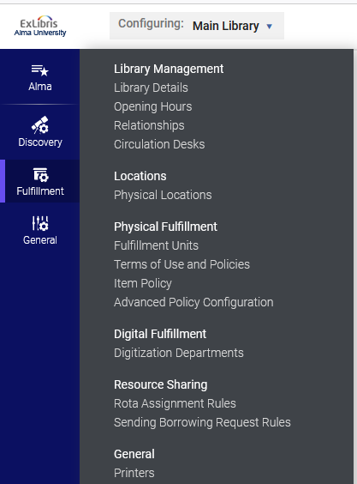
Accessing the Circulation Desk Configurations

Slide 8
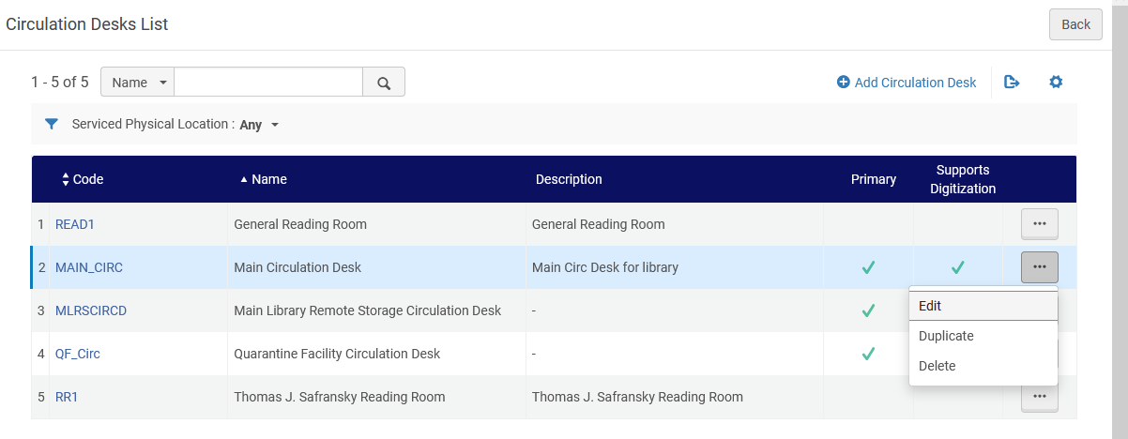
Accessing the Circulation Desk Configurations

Slide 9
A "Circulation Only" Circulation Desk

Slide 10
A "Circulation Only" Circulation Desk
If a circulation desk will be used for “Circulation Only” then it will have no “Work Order Types” in the “Work Order Types” tab of the circulation desk.
For example, if the staff working at the circulation desk will not also be doing acquisitions receiving, then there will not be a Work Order Type of “Acquisitions Technical Services” (or similarly names work order type which will correspond to an acquisitions work order)

Slide 11
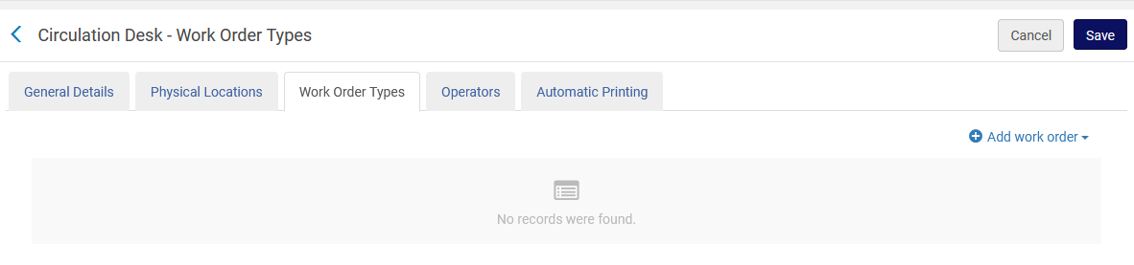
A "Circulation Only" Circulation Desk
Empty. No work order types have been added.

Slide 12

A "Circulation Only" Circulation Desk
The logged in staff user is at the “2nd floor circulation desk”

Slide 13
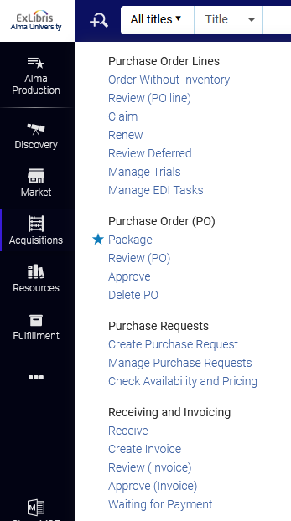
A "Circulation Only" Circulation Desk
While at the “2nd floor circulation desk” we access “Acquisitions > Receiving and Invoicing > Receive”

Slide 14

A "Circulation Only" Circulation Desk
Because this is a "Circulation Only" circulation desk, the logged in staff user at the “2nd floor circulation desk” cannot do the “Receiving”, and instead will receive this message:
Note that in this case the logged in staff user has the relevant roles to do “Receiving” (and thus it appears in the menu) but is not in the correct circulation desk or acquisitions department.

Slide 15
A "Circulation and Acquisitions" Circulation Desk

Slide 16
A "Circulation and Acquisitions" Circulation Desk
In some institutions the same employee may do both acquisitions receiving and circulation activities (such as loans and returns).
Rather than making the user switch between a “Circulation Desk” (when doing circulation activities) and a “Receiving Department” (when doing acquisitions receiving), it is possible to make the circulation desk be able to do both activities.
This way the staff user won’t need to select a different location when switching between “Circulation Activities” and “Acquisition's receiving”

Slide 17
A "Circulation and Acquisitions" Circulation Desk
In order to make the circulation desk be able to do both circulation activities and acquisitions receiving a Work Order Type of “Acquisitions Technical Services” (or similarly names work order type which will correspond to an acquisitions work order) should be added to the “Work Order Types” tab of the circulation desk.

Slide 18
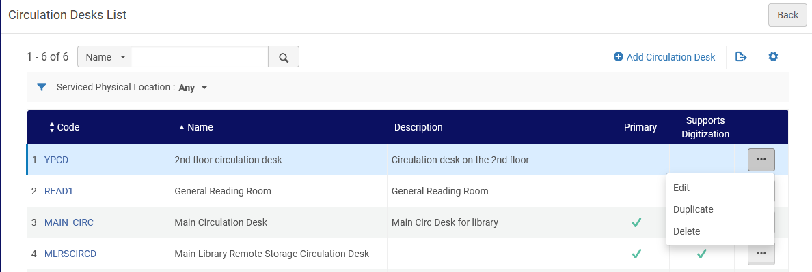
A "Circulation and Acquisitions" Circulation Desk
Here we will edit the “2nd floor circulation desk”

Slide 19
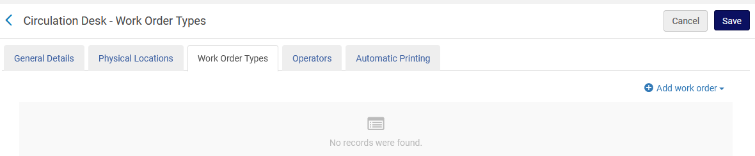
A "Circulation and Acquisitions" Circulation Desk
In the “Work Order Types” tab we will add a work order type

Slide 20
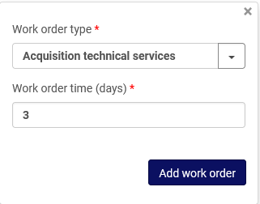
A "Circulation and Acquisitions" Circulation Desk
We will choose “Acquisitions Technical Services”

Slide 21
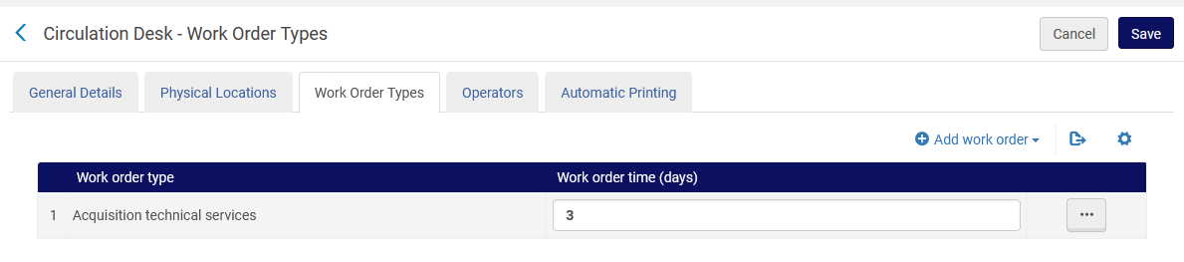
A "Circulation and Acquisitions" Circulation Desk
The Work Order Type has been added

Slide 22
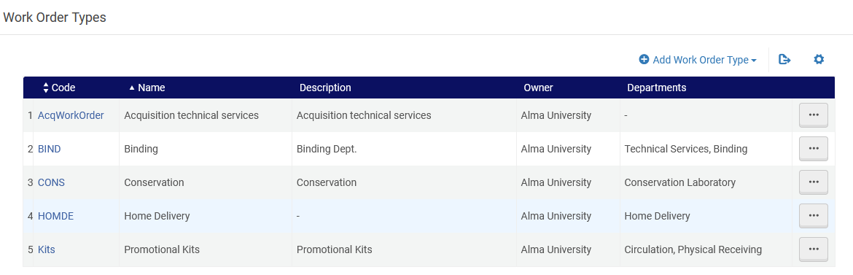
A "Circulation and Acquisitions" Circulation Desk
A “General Information” Note: We added “Acquisitions Technical Services”. The full list of work order types and their definitions may be access at “Configuration Menu > General > Choose an institution or a library > Work Orders and Departments > Work Order Types
This is the one we added to the circulation desk

Slide 23
A "Circulation and Acquisitions" Circulation Desk
The logged in staff user is again at the “2nd floor circulation desk”

Slide 24
A "Circulation and Acquisitions" Circulation Desk
While at the “2nd floor circulation desk” we again access “Acquisitions > Receiving and Invoicing > Receive”

Slide 25
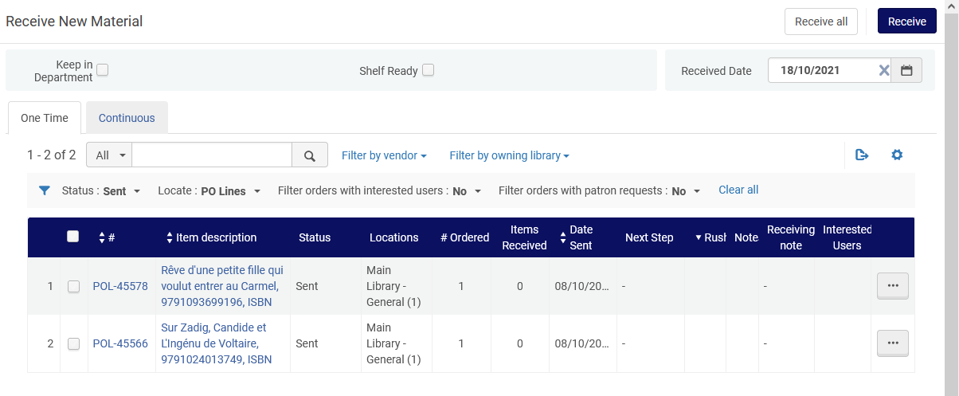
A "Circulation and Acquisitions" Circulation Desk
Instead of getting the message “No acquisition department was selected” (as happened last time) we now can receive acquisitions items

Slide 26
A "Circulation and Digitization" Circulation Desk

Slide 27
A "Circulation and Digitization" Circulation Desk
It is possible to define that a circulation desk will “support digitization” and thereby act as a digitization department.
This is useful in the case of an institution not having a dedicated separate “digitization department”, but rather that all digitization activities are done at the circulation desk.
In this manner if a staff user does both circulation and digitization activities, he or she can do all activities at one location without needing to change the “currently at” setting, switching back and forth from a circulation desk to a digitization department.

Slide 28
A "Circulation and Digitization" Circulation Desk
The option to define that the circulation desk will act as a digitization department is defined in the “General” tab in the “Digitization Department” section by selecting the checkbox “Supports Digitization”.
In the example here we will show what happens before and after selecting the checkbox “Supports Digitization” for the Circulation Desk named “2nd floor circulation desk”.
We will then do a workflow using the “2nd floor circulation desk” as a digitization department.

Slide 29
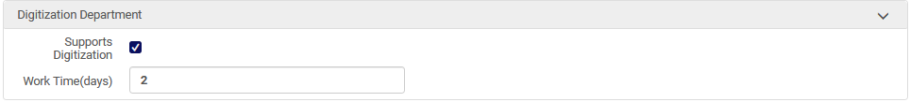
A "Circulation and Digitization“ Circulation Desk
In the “General Details” tab of the “2nd floor circulation desk” the “Supports Digitization” checkbox is not checked:
In the “General Details” tab of the “Main Circulation Desk” the “Supports Digitization” checkbox is checked:

Slide 30
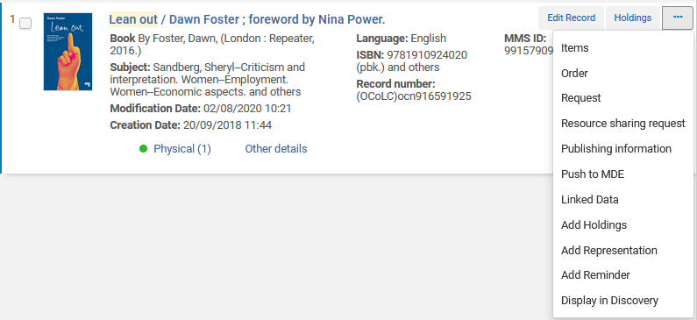
A "Circulation and Digitization" Circulation Desk
Within Alma we will make a staff digitization request and see what departments we may choose for the request

Slide 31
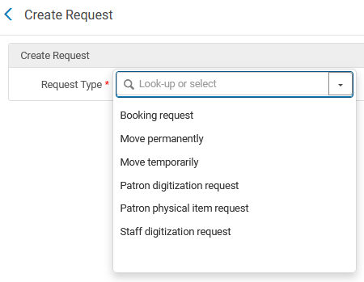
A "Circulation and Digitization" Circulation Desk
We will choose “Staff Digitization Request”

Slide 32
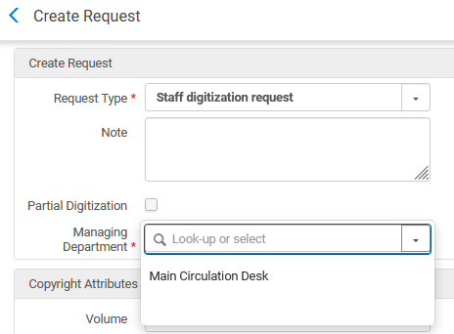
A "Circulation and Digitization" Circulation Desk
The only “Managing Department” which appears is the “Main Circulation Desk” because it is the only one with “Supports Digitization” checked.

Slide 33
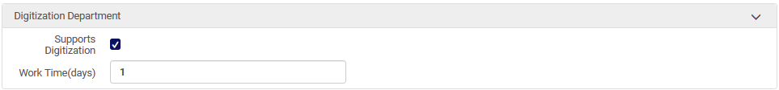
A "Circulation and Digitization" Circulation Desk
Now for circulation desk “2nd Floor Circulation Desk” will check the box “Supports Digitization”

Slide 34
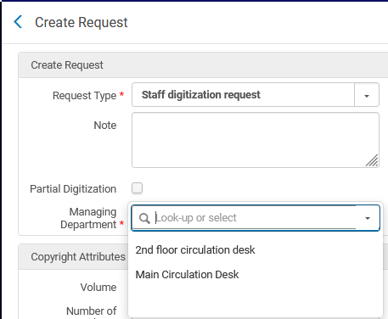
A "Circulation and Digitization" Circulation Desk
Now we will again create a staff digitization request and we do see the “2nd floor circulation desk”

Slide 35
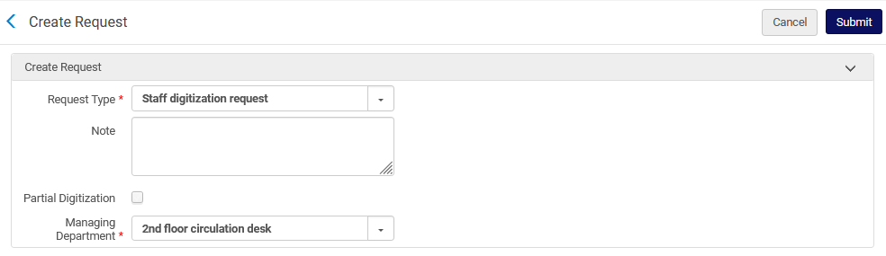
A "Circulation and Digitization" Circulation Desk
We will create the digitization request with the department being the “2nd Floor Circulation Desk”

Slide 36
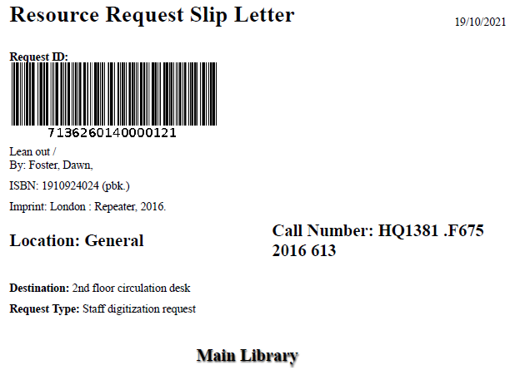
A "Circulation and Digitization" Circulation Desk
The staff digitization request is created

Slide 37
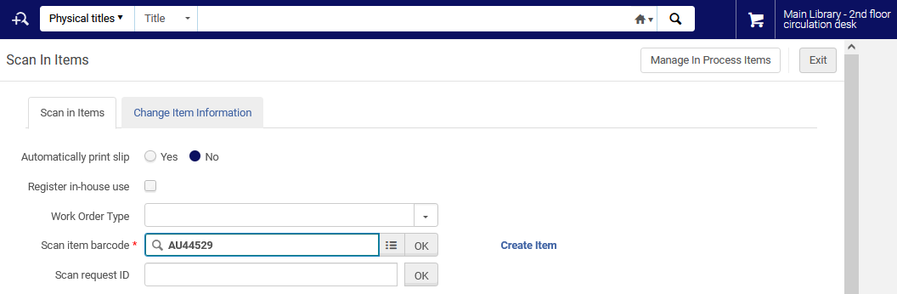
A "Circulation and Digitization" Circulation Desk
The item is scanned in at the “2nd Floor Circulation Desk”

Slide 38
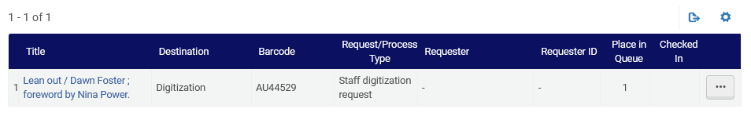
A "Circulation and Digitization" Circulation Desk
The processing of the request can begin at the “2nd Floor Circulation Desk”

Slide 39
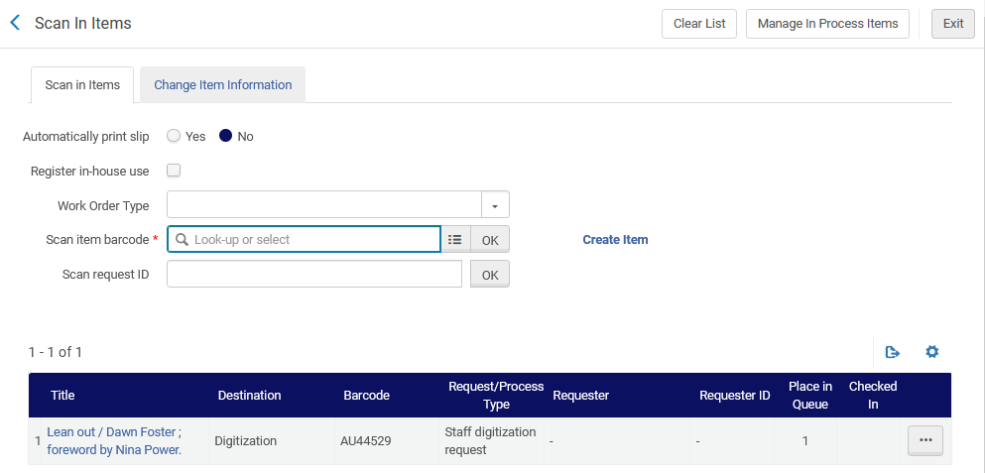
A "Circulation and Digitization" Circulation Desk
After scanning in the item we can click “Manage in process items” (or we can access this from the Fulfillment menu)

Slide 40
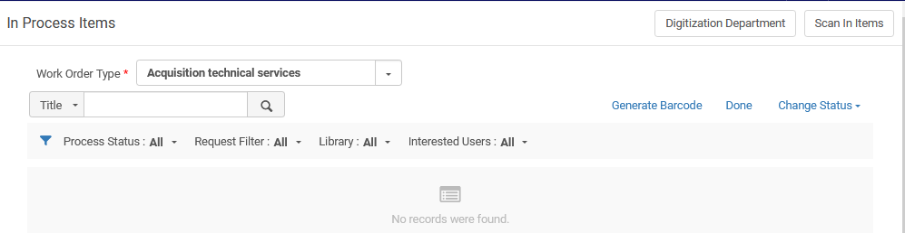
A "Circulation and Digitization" Circulation Desk
From the “Manage in process items” we can click “Digitization Department”

Slide 41
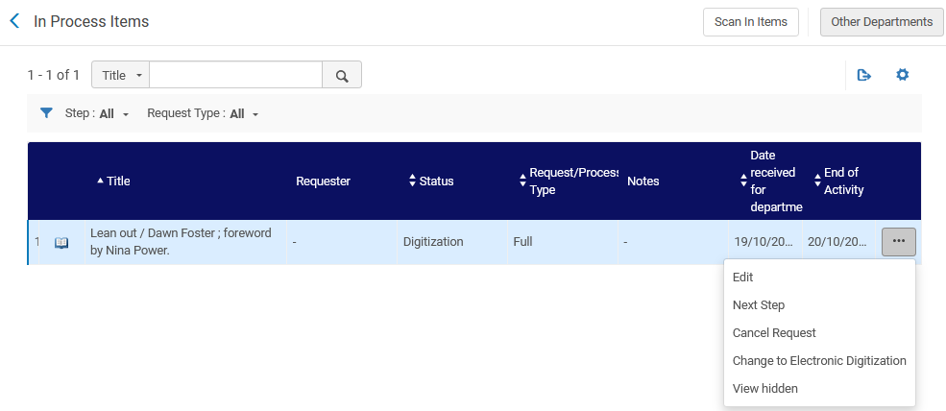
A "Circulation and Digitization" Circulation Desk
Now we will choose “Next Step”

Slide 42
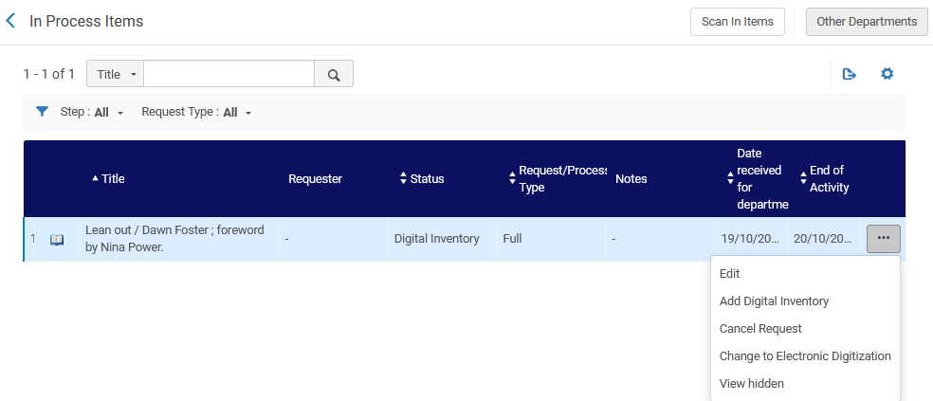
A "Circulation and Digitization" Circulation Desk
Now we will add the Digital Inventory (which we already scanned)

Slide 43
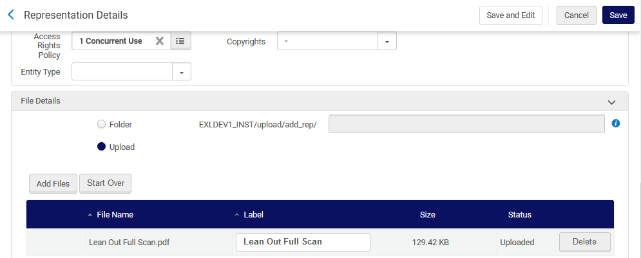
A "Circulation and Digitization" Circulation Desk
We upload the file and save

Slide 44

A "Circulation and Digitization" Circulation Desk
The process is complete so we will again scan in the item (still at the 2nd floor circulation desk)

Slide 45
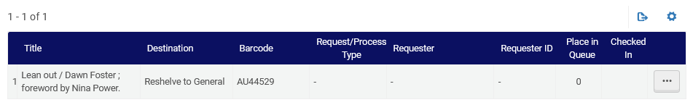
A "Circulation and Digitization" Circulation Desk
Now the item will go back to its place in the stacks

Slide 46
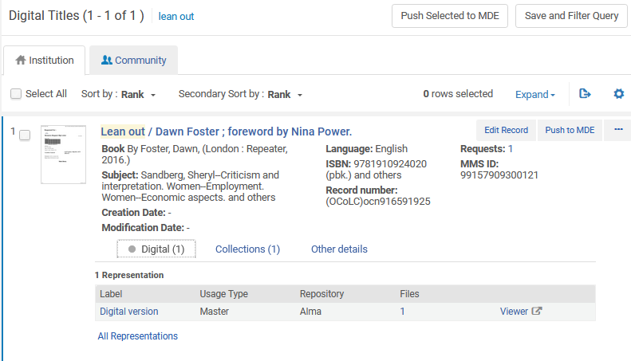
A "Circulation and Digitization" Circulation Desk
The Digital File has been attached to the Digital Representation for the record

Slide 47
A circulation desk which can register new users

Slide 48
A circulation desk which can register new users
It is possible to define that a circulation desk has the option to register new users.
This may be useful, for example, if a patron comes to loan an item and is not yet registered. The staff can add the patron “on the spot” and then loan him or her the item.
We will first show an example where the circulation desk is not defined to be able to register new users.
Then we will first show an example where the circulation desk is defined to be able to register new users.

Slide 49
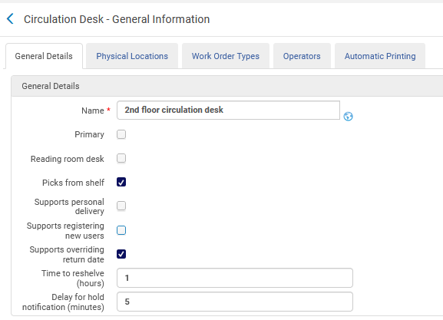
A circulation desk which can register new users
Currently the “2nd floor circulation desk” does not have “Supports registering new users” checked

Slide 50
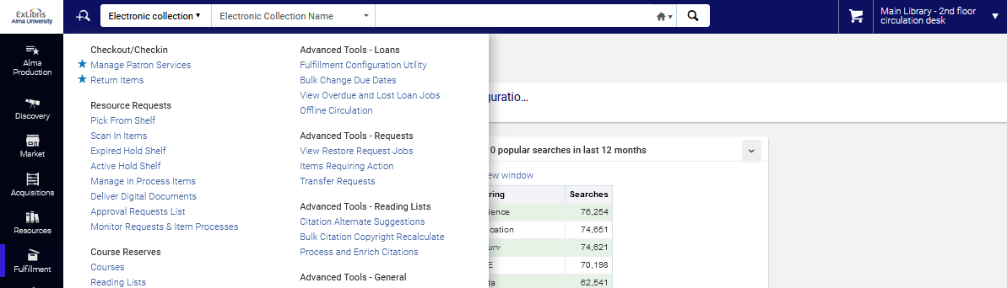
A circulation desk which can register new users
While at the “2nd floor circulation desk” we access “Manage Patron Services”

Slide 51
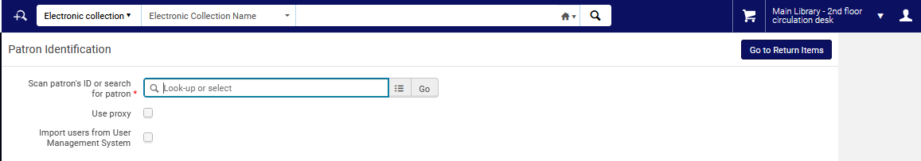
A circulation desk which can register new users
There is no option to register a new user

Slide 52
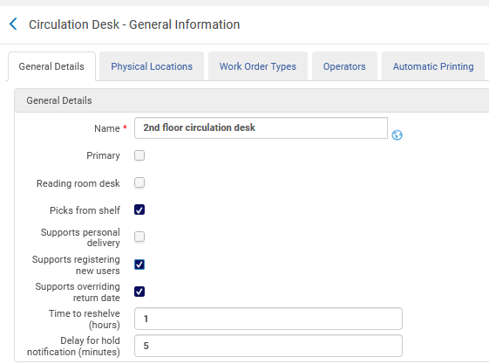
A circulation desk which can register new users
Now we have edited the “2nd floor circulation desk” so that it does have “Supports registering new users” checked

Slide 53
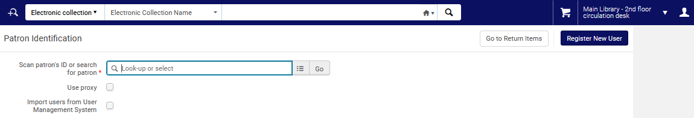
A circulation desk which can register new users
Now when we do “Manage Patron Services” we have an option to add a new user

Slide 54
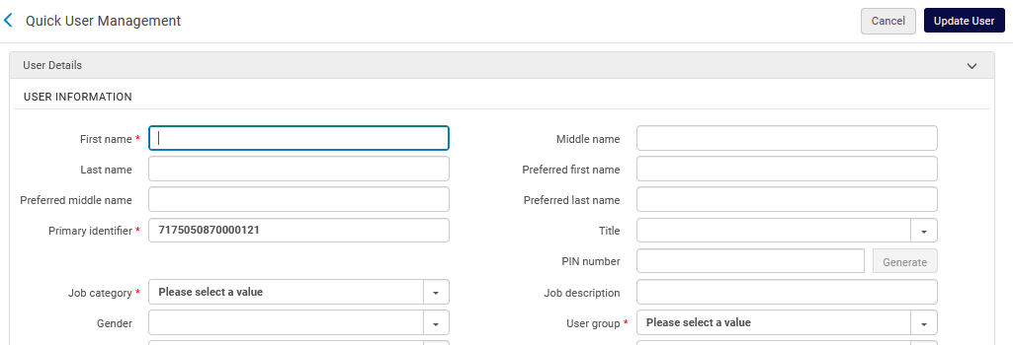
A circulation desk which can register new users
After clicking “Register New User” we can add a new user

Slide 55
A circulation desk which can accept payments for fines and fees

Slide 56
A circulation desk which can accept payments for fines and fees
It is possible to define that a circulation desk has the option to accept payments for fines and fees.
We will first show an example where the circulation desk is not defined to be able to accept payments for fines and fees.
Then we will first show an example where the circulation desk is defined to be able to accept payments for fines and fees.

Slide 57
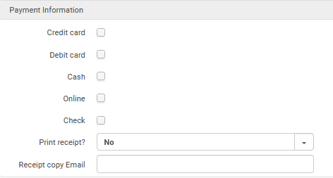
A circulation desk which can accept payments for fines and fees
In the “General Details” tab of the circulation desk the “Payment Information” section has no options chosen.

Slide 58
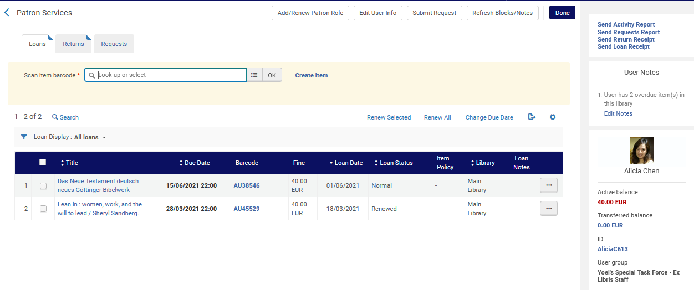
A circulation desk which can accept payments for fines and fees
Patron has an active balance of 40.00 EUR, and there is no link to receive payment

Slide 59
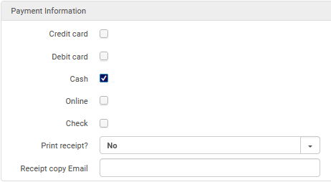
A circulation desk which can accept payments for fines and fees
In the “General Details” tab of the circulation desk the “Payment Information” section has the option for Cash chosen.

Slide 60
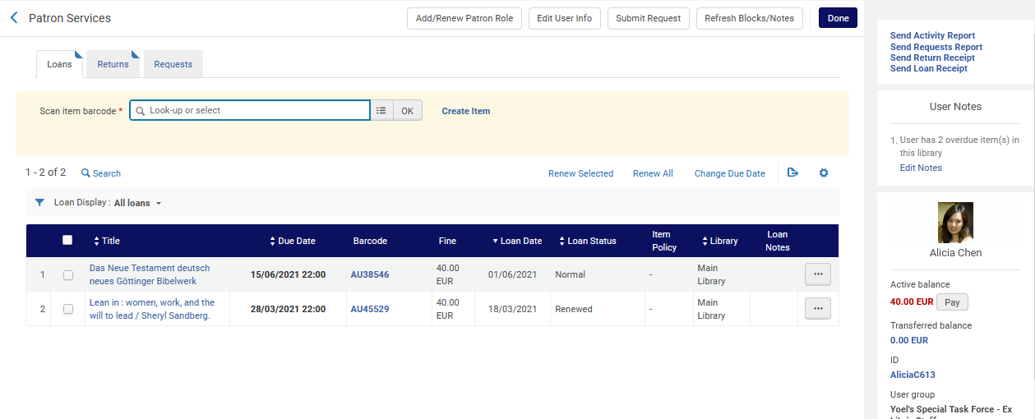
A circulation desk which can accept payments for fines and fees
Patron has an active balance of 40.00 EUR, and there is a link to receive payment

